Slide 1


football_player_sale
Lorenzo Orsini, Gianluca Di Tuccio

Slide 2
Introduction
Tools and dataset
Domain of football transfer market;
Decision of selling a player based on various criteria;
Pgmpy and PrettyTable with Anaconda;
Queries with Variable Elimination (interactively selected by the user);
Likelihood Weighting;
Dataset of the Serie A, season 2019/20 (https://fbref.com/en/comps/11/3260/stats/2019-2020-Serie-A- 2 Stats#all_stats_standard);

Slide 3
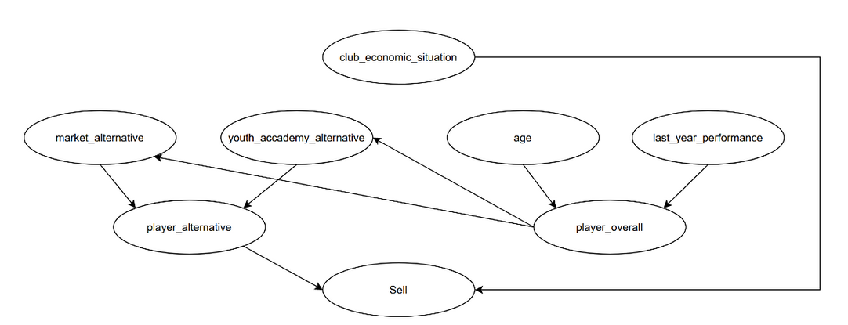
Bayesian network

Slide 4
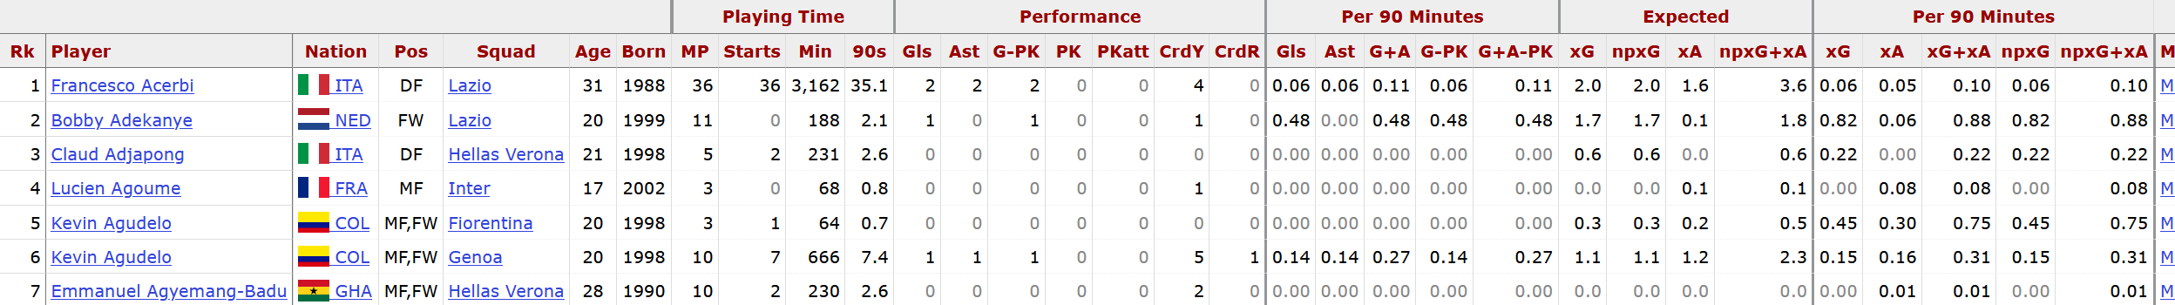
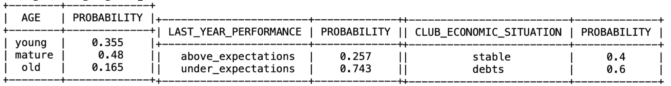
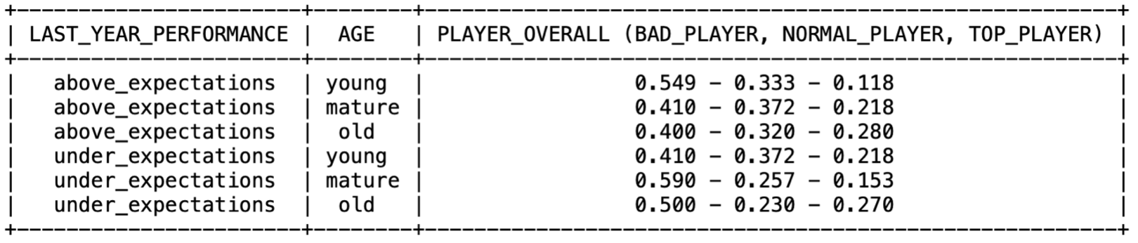
CPDs and dataset
https://fbref.com/en/comps/11/3260/stats/2019-2020-Serie-A- 2 Stats#all_stats_standard
Club situation: economic balance;
Age and last_year_performance from dataset;
last_year_performance also based on presences, goals (or clean sheets) and assists of season 2018/19;
Player_overall based on last_year_performance and age.

Slide 5
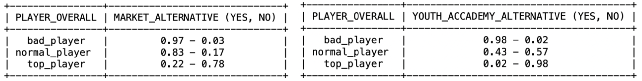
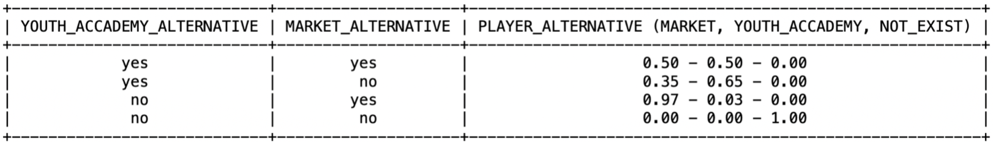
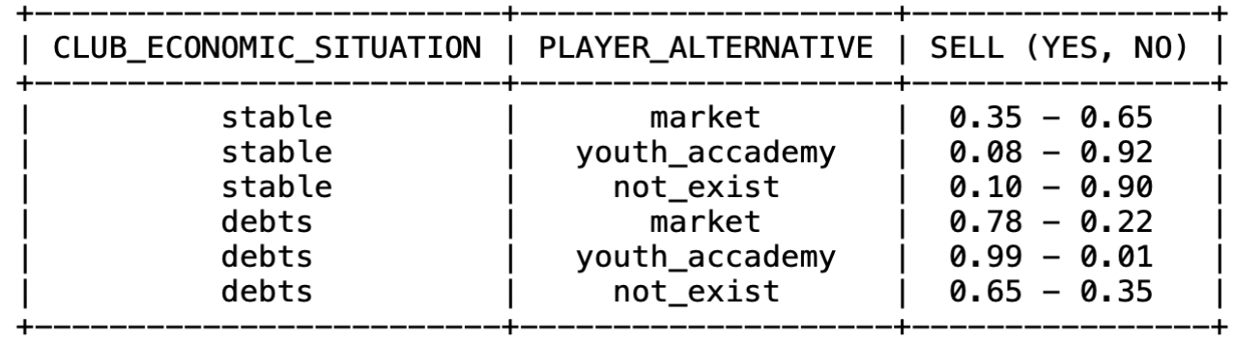
CPDs
Market_Alternative: based on players with the same player_overall in the dataset;
youth_accademy_alternative: as market_alternative, but based on the under21 trasnfermarkt stats;
Probabilities of player_alternative by merging the results of market and youth academy alternative;
50 – 50 probabilities for both alternatives;
Adding the variable not_exist;
Sell based on the club_economic_situation and player_alternative;

Slide 6
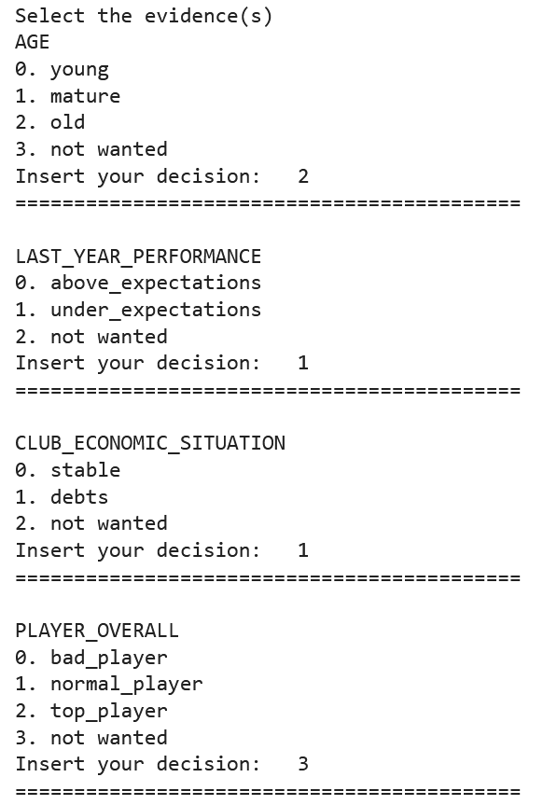
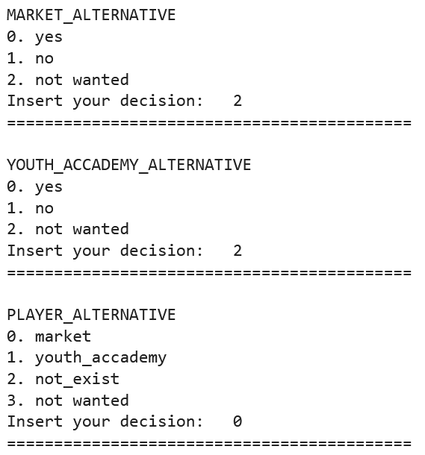
Queries (variable elimination)
User can select his customized queries;
Variable Elimination with VariableElimination pgmpy function;

Slide 7
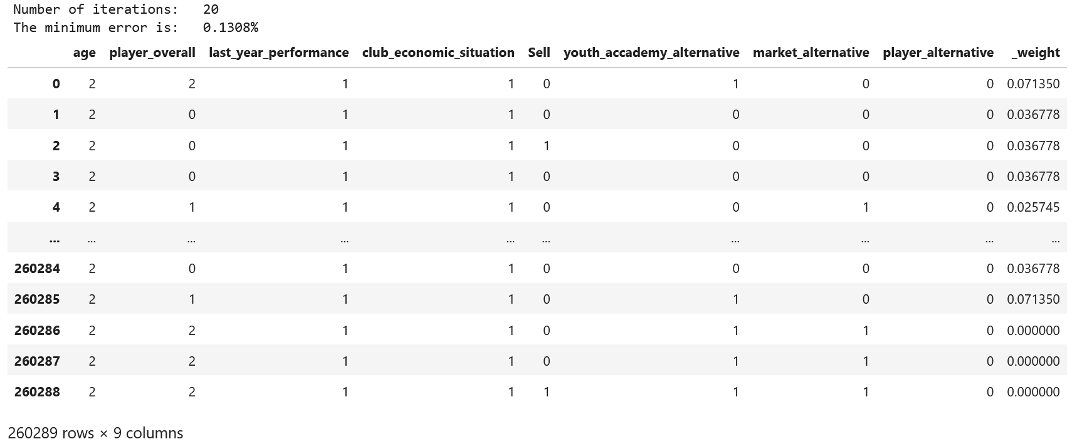
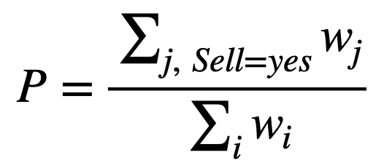
Likelihood weighting
260289 samples generated;
20 iterations with logspace distance;
Changed the seed at each iteration;
Probability calculated with:

Slide 8
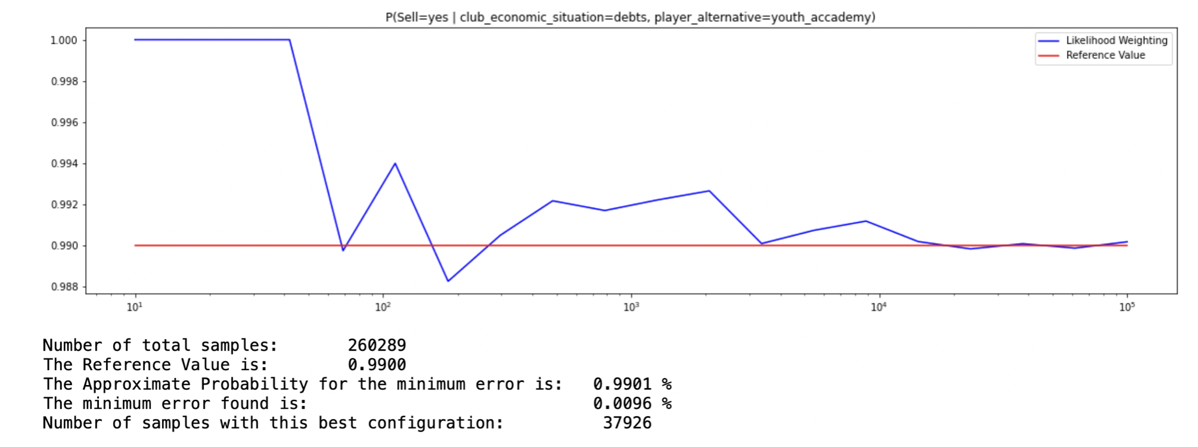
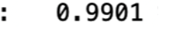
conclusion

